Slide 1
THE QUALIFIED OPPORTUNITY ZONE PROGRAM
Clarence Williams,
Senior Government Consultant
Becker & Poliakoff PA

Slide 2
The Why…
Created in the 2017 Tax Cuts and Jobs Act
Looks to take advantage of an estimated $6 Trillion in unrealized capital gains
Creates a tremendous investment opportunity to spur the movement of private capital
Opportunity Zones are hoped to be a powerful new tool for mobilizing capital for real estate projects that create jobs, improve communities, and spur economic growth.

Slide 3
The Law
Authorizes the U.S. Treasury to provided preferential tax treatment for investments in certain geographic locations around the country
Allows the Governors of all 50 states to designate certain census tracts as Opportunity Zones
Looks to spur investment in historically underutilized and underdeveloped communities
Governors selected and the Treasury designated over 8700 Opportunity Zones
Former Florida Governor Rick Scott designated 427 communities in Florida

Slide 4
For the Investors
The tax benefits for these investments include:
A temporary tax deferral for capital gains reinvested in a Qualified Opportunity Zone
A step-up in basis for any investment in a QOF held for at least five years (10% basis increase) or seven years (15% basis increase), and
A permanent exclusion of capital gains taxes on any gain from the original investment if the investment is held for at least ten years.

Slide 5
Forming a Qualified Opportunity Zone Fund
Investments in QOZs must be made via an Opportunity Zone Fund to qualify for tax benefits. There are no statutory limits on who may form an OZ Fund, but there are other requirements:
May be a partnership or corporation organized for the purpose of investing in QOZ property;
Must hold at least 90% of its assets in QOZ property, which can be stock, partnership interests and/or other tangible property used in a trade or business, (e.g. real estate), within a QOZ; and
Must be certified according to IRS and Treasury regulations.
Proposed rules released by the Treasury Department in October 2018 state that OZ Funds will be able to self-certify via a form on their federal tax returns (Form 8996), which is also how they will certify that they fulfill the “90% asset” requirement.

Slide 6
QOZ Business Property
The statute requires that QOZ business property either be new or be substantially improved, which means investing at least as much on the improvement as was paid for the used asset, not including the value of the land.
The law requires that property be improved for other than its “original” use. If a building was used as a warehouse in its former life, it must be used for some other purpose than its “original use,” a term that will be clarified in future regulation.
In addition, QOZ business property must be “substantially all” in a QOZ. The proposed rules state that this requirement will be met if 70% or more of the property is in a QOZ. For instance, if a franchisee looks to own five restaurants, at least four must be in the QOZ to be eligible as a QOZ business.

Slide 7
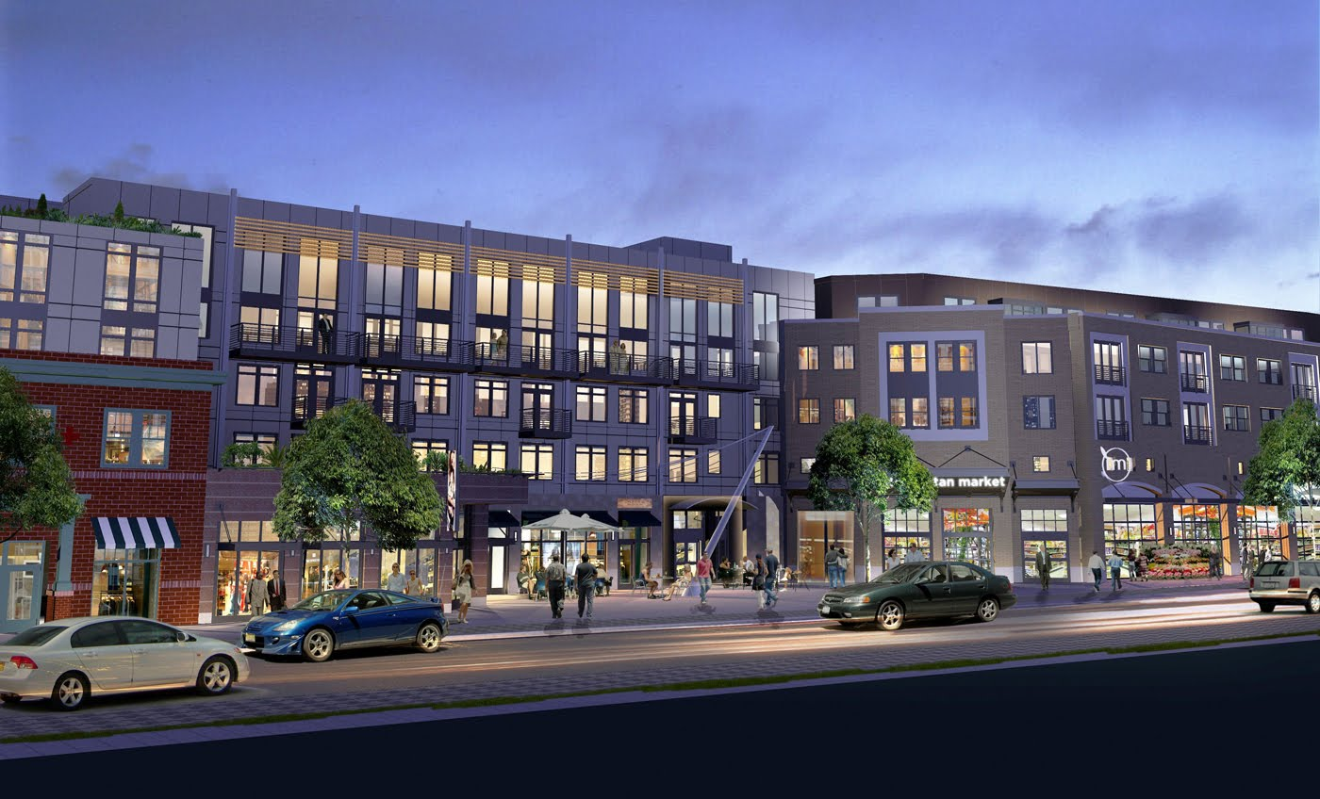
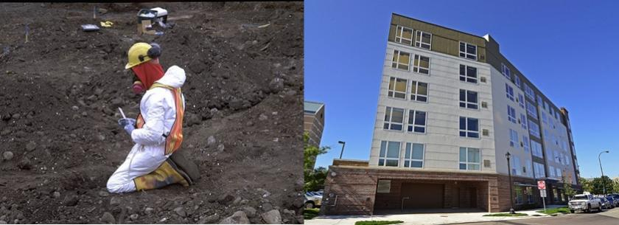
Emerging Uses for Investment Capital
Eligible Opportunity Zone businesses are more wide-ranging than in previous programs, including investments such as residential rental property businesses, which were excluded by the earlier programs. The additional businesses may be lower risk for investors but with a risk that they may be less beneficial for the community.
Some allowable investments under the QOZ program include:
Supporting Entrepreneurs and Growing Businesses
Start ups
Growth stage business expansion
Franchising
Real Estate
Redevelopment of commercial property
Incubator space for entrepreneurs
Mixed-use properties
Housing – both market-rate and affordable
Energy Infrastructure
Brownfields Redevelopment
Innovation Districts

Slide 8
OPERATIONALLY…
Under the new guidelines, Opportunity Funds have 31 months from receiving capital from investors before they must invest the capital into an actual project
— provided that they have a plan to do so within six months of receiving the capital.
That means investors can have the confidence to invest in Opportunity Funds with a pipeline of projects that might take longer to come to fruition.
Under the final guidelines, at least 50 percent of the gross income of an eligible business must come from “the active conduct of a trade or business in the qualified Opportunity Zone.”
The IRS also created a “70-30 rule,” permitting up to 30 percent of an eligible business’ property to be located outside a designated Opportunity Zone.

Slide 9
Incentives and Additional Funding
In the best case scenarios, QOZ financing will make up a significant portion of development projects. Regulations allow the mingling of financing options with QOZ incentives:
Other federal incentives like New Market Tax Credits, Historic Tax Credit program, and grants from federal agencies like the Economic Development Agency, the USDA, or HUD, for instance;
Historical equity financing, debt instruments, or lease arrangements;
Conform with IRC; further enhancement to keep investment local ;
States spend billions of dollars a year on tax credits, deductions, and exemptions that are meant to encourage businesses to create or retain jobs and make investments.

Slide 10
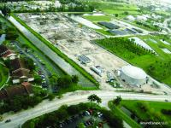
Forging Corporate/Public Partnerships
Public Private Partnerships (PPP) afford local governments another option to improve roads, sewers, schools and other public assets with less effect on tight budgets.
Miami People Mover Davie Wasterwater Reclamation Miami Marlins Stadium

Slide 11
KEY POINTS TO CONSIDER
There are 8,700 Opportunity Zones nationwide, which are qualifying low-income census tracts designated by state governors as areas for investment with the potential to benefit communities and investors alike.
The Opportunity Zone program, conceived by the federal government to drive private investment into low-income areas using major tax incentives, will tap nearly $6.1 trillion of unrealized capital gains.
According to early research conducted by the Council of Development Finance Agencies (CDFA), OZ fund capital will only meet between 5 percent and 30 percent of the dollars needed for a project.
Funds are national, as well as built around specific projects
Collaborate with CRDA’s around their project lists
Important to account for QOZ property adjacent to high-growth areas, as well as, property immediately adjacent to QOZ property.
Most investment is falling into the $5m-$50m area, and initially on multi-family developments.

Slide 12
FOR ADDITIONAL INFORMATION…
PLEASE CONTACT:
Clarence Williams Philip Rosen
Senior Government Consultant or Chair, Real Estate Practice Grp
clwilliams@beckerlawyers.com prosen@beckerlawyers.com
202-725-8770 (Washington DC) 954-364-6026

